Slide 1
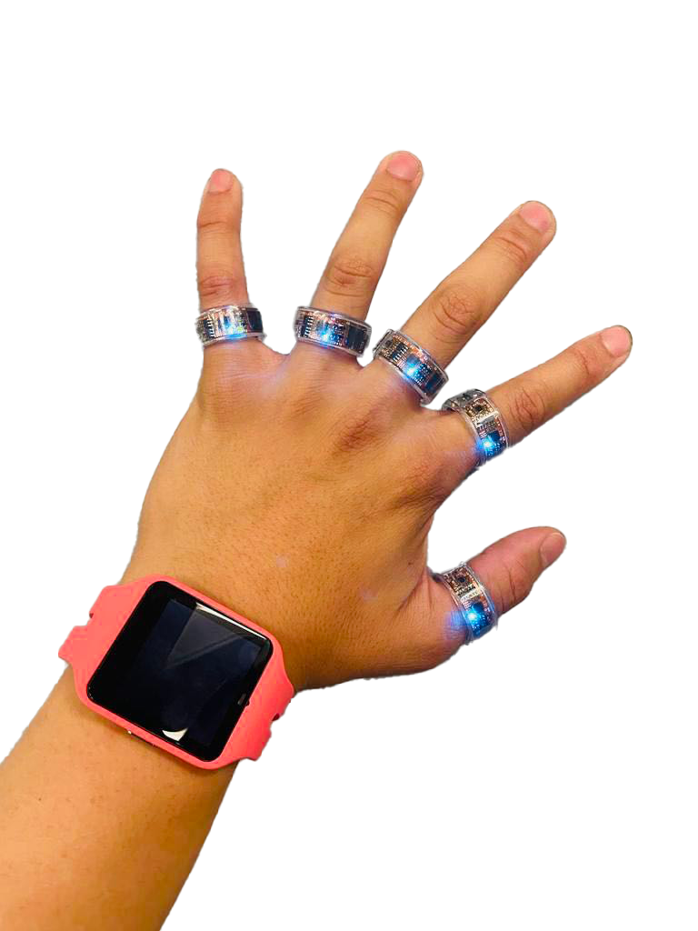

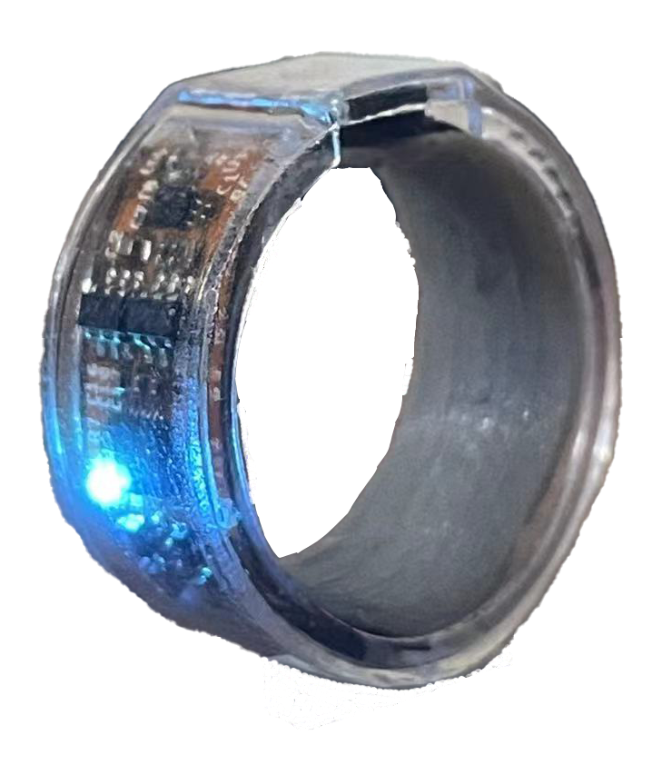
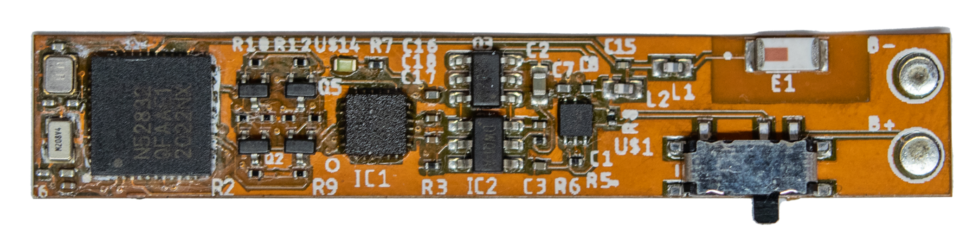
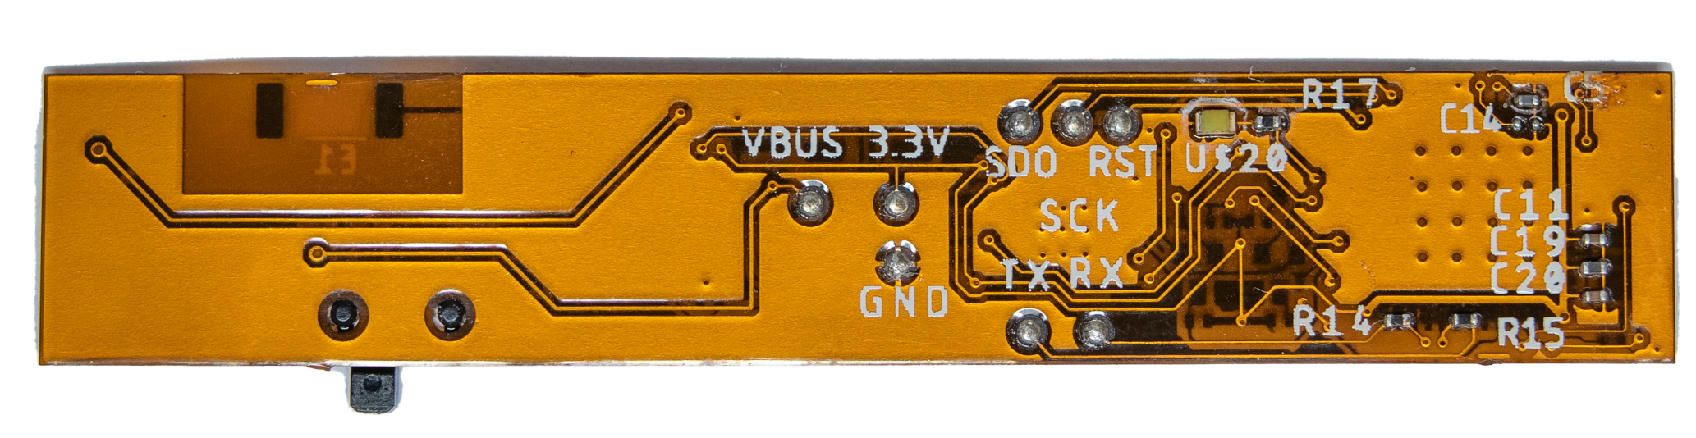
SPI
BLE
46.2 mm
Sensor Rings
9-axis
IMU
NRF52832
SoC
8.3
mm
Voltage regulator
Ring Diameter: 11mm
Battery: 15mAH
Weight: 2.8g
Lithium Battery
(a)
(b)
(c)

Slide 2
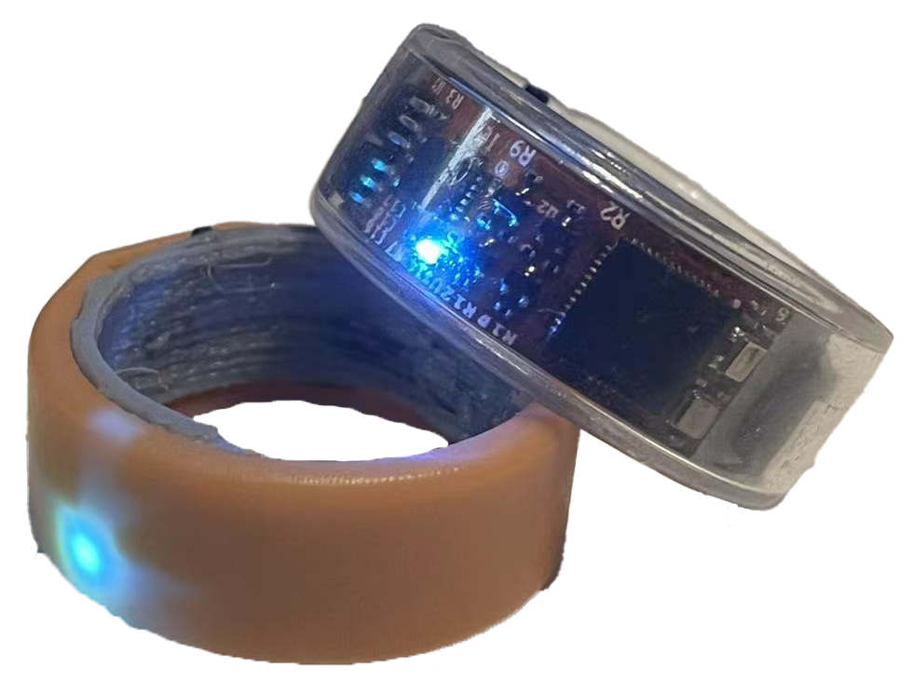
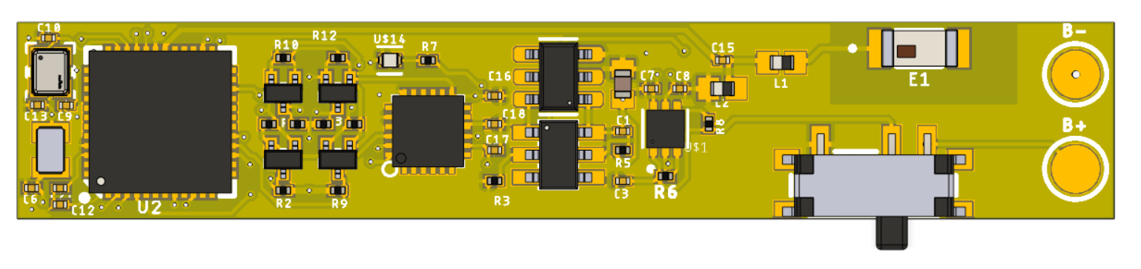
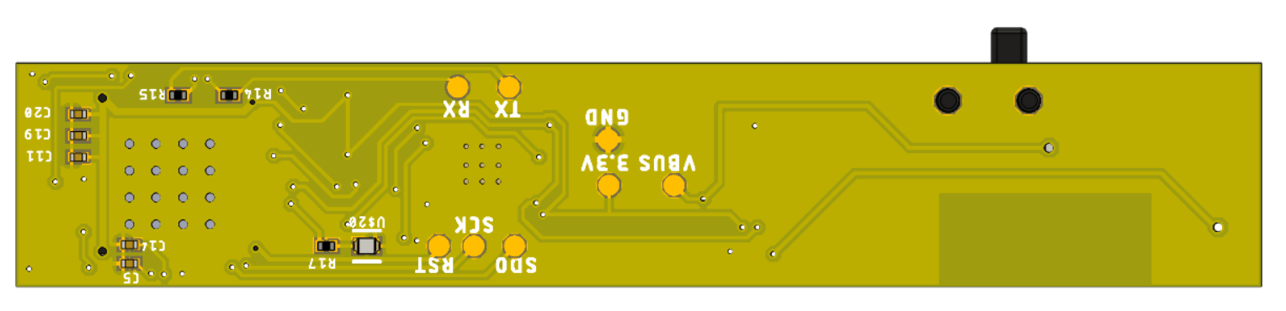
SPI
BLE
46.2 mm
Sensor Rings
9-axis
IMU
NRF52832
SoC
8.3
mm
Voltage regulator
Ring radius: 10mm
Battery: 15mAH
Weight: 2.8g
Lithium Battery
(a)
(b)
(c)

Slide 3
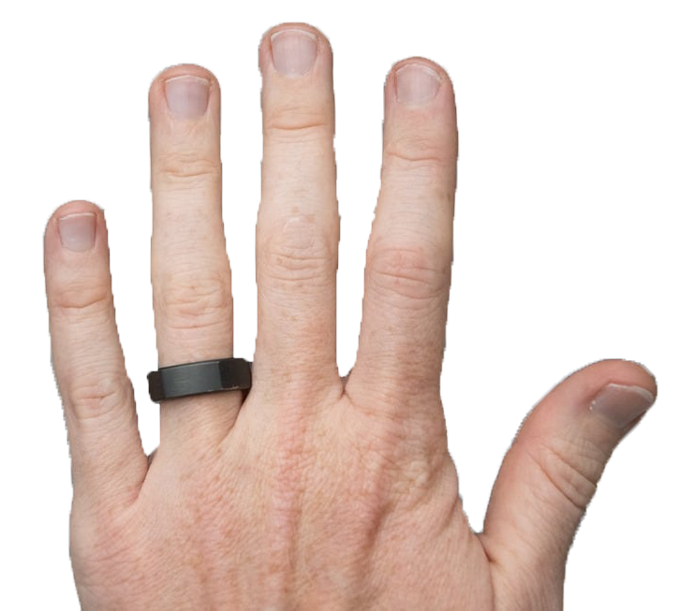
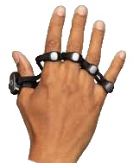
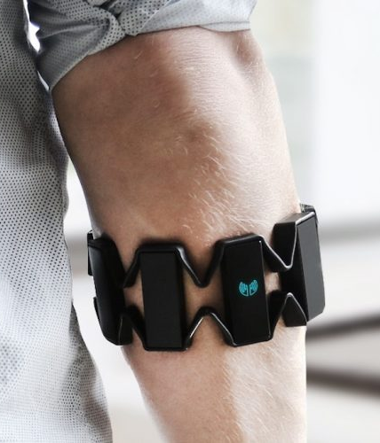
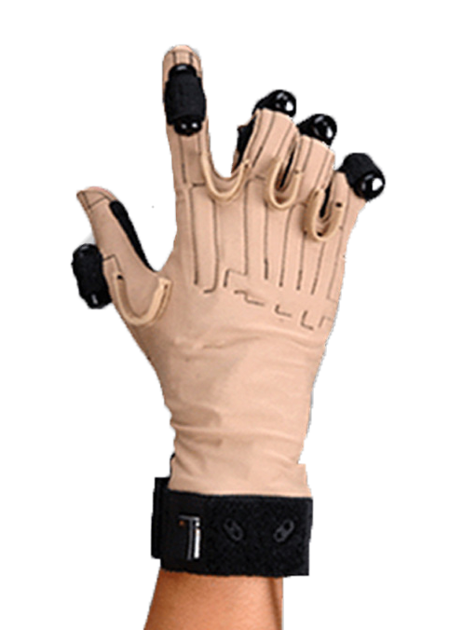
Ring (Zip)
Tapstrap
Platform
Comfort
Weight
Appearance
Platform
Comfort
Weight
Appearance
9.5
9.8
9.7
8.2
7.6
8.6
Myo EMG
CyberGlove
Platform
Comfort
Weight
Appearance
Platform
Comfort
Weight
Appearance
>Guide to Transparent 3D Printing
8.0
6.4
3.6
4.2
2.2
6.4

Slide 5
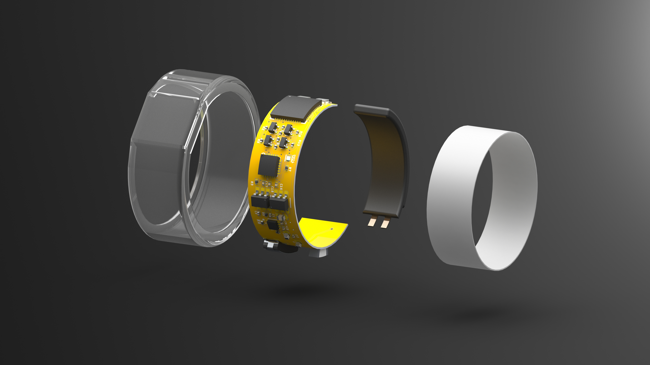
SoC
nRF52832
9-axis IMU /
ICM20948
SPI
TPU
Housing
Bluetooth /
BLE
Clear Resin
Cover
15mAh Li-Po
Battery
Slide
Button

Slide 6
